Slide 1
Spring overview
Course “Spring – first touch”
Section 5

Slide 2
Agenda
Spring Framework modules
Spring Framework features

Slide 3
SPRING FRAMEWORK MODULES

Slide 4
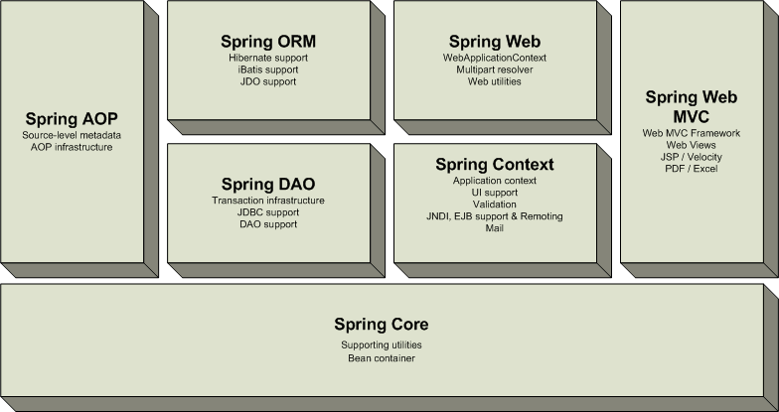
Spring Core module

Slide 5
Spring Context module

Slide 6
Spring DAO and ORM modules

Slide 7
Spring Web modules

Slide 8
Spring AOP module

Slide 9
Spring Framework modules

Slide 10
SPRING FRAMEWORK FEATURES

Slide 11
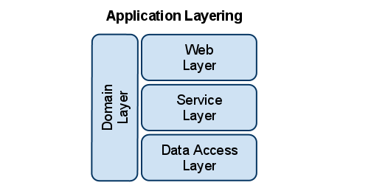
Spring features (1)
Decoupled software layers
Notes:
Allows to decouple software layers by injecting a component’s dependencies at runtime rather than having them declared at compile time via importing and instantiating classes.
Spring provides integration for J2EE services such as EJB, JDBC, JNDI, JMS, JTA. It also integrates several popular ORM toolkits such as Hibernate and JDO and assorted other services as well.
One of the highly touted features is declarative transactions, which allows the developer to write transaction-unaware code and configure transactions in Spring config files.
Spring is built on the principle of unchecked exception handling. This also reduces code dependencies between layers. Spring provides a granular exception hierarchy for data access operations and maps JDBC, EJB, and ORM exceptions to Spring exceptions so that applications can get better information about the error condition.
With highly decoupled software layers and programming to interfaces, each layer is easier to test. Mock objects is a testing pattern that is very useful in this regard.

Slide 12
Spring features (2)
Integration for J2EE services:
  EJB
  JDBC
  JNDI
  JMS
  JTA
  etc.
Notes:
Allows to decouple software layers by injecting a component’s dependencies at runtime rather than having them declared at compile time via importing and instantiating classes.
Spring provides integration for J2EE services such as EJB, JDBC, JNDI, JMS, JTA. It also integrates several popular ORM toolkits such as Hibernate and JDO and assorted other services as well.
One of the highly touted features is declarative transactions, which allows the developer to write transaction-unaware code and configure transactions in Spring config files.
Spring is built on the principle of unchecked exception handling. This also reduces code dependencies between layers. Spring provides a granular exception hierarchy for data access operations and maps JDBC, EJB, and ORM exceptions to Spring exceptions so that applications can get better information about the error condition.
With highly decoupled software layers and programming to interfaces, each layer is easier to test. Mock objects is a testing pattern that is very useful in this regard.

Slide 13
Spring features (3)
Integration with popular ORM frameworks:
  Hibernate
  JPA
  TopLink
  etc.
Notes:
Allows to decouple software layers by injecting a component’s dependencies at runtime rather than having them declared at compile time via importing and instantiating classes.
Spring provides integration for J2EE services such as EJB, JDBC, JNDI, JMS, JTA. It also integrates several popular ORM toolkits such as Hibernate and JDO and assorted other services as well.
One of the highly touted features is declarative transactions, which allows the developer to write transaction-unaware code and configure transactions in Spring config files.
Spring is built on the principle of unchecked exception handling. This also reduces code dependencies between layers. Spring provides a granular exception hierarchy for data access operations and maps JDBC, EJB, and ORM exceptions to Spring exceptions so that applications can get better information about the error condition.
With highly decoupled software layers and programming to interfaces, each layer is easier to test. Mock objects is a testing pattern that is very useful in this regard.

Slide 14
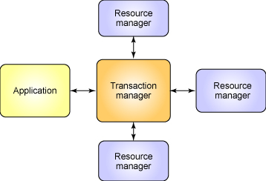
Spring features (4)
Support for declarative transactions
Notes:
Allows to decouple software layers by injecting a component’s dependencies at runtime rather than having them declared at compile time via importing and instantiating classes.
Spring provides integration for J2EE services such as EJB, JDBC, JNDI, JMS, JTA. It also integrates several popular ORM toolkits such as Hibernate and JDO and assorted other services as well.
One of the highly touted features is declarative transactions, which allows the developer to write transaction-unaware code and configure transactions in Spring config files.
Spring is built on the principle of unchecked exception handling. This also reduces code dependencies between layers. Spring provides a granular exception hierarchy for data access operations and maps JDBC, EJB, and ORM exceptions to Spring exceptions so that applications can get better information about the error condition.
With highly decoupled software layers and programming to interfaces, each layer is easier to test. Mock objects is a testing pattern that is very useful in this regard.

Slide 15
Spring features (5)
Built on the principle of unchecked exception handling
Notes:
Allows to decouple software layers by injecting a component’s dependencies at runtime rather than having them declared at compile time via importing and instantiating classes.
Spring provides integration for J2EE services such as EJB, JDBC, JNDI, JMS, JTA. It also integrates several popular ORM toolkits such as Hibernate and JDO and assorted other services as well.
One of the highly touted features is declarative transactions, which allows the developer to write transaction-unaware code and configure transactions in Spring config files.
Spring is built on the principle of unchecked exception handling. This also reduces code dependencies between layers. Spring provides a granular exception hierarchy for data access operations and maps JDBC, EJB, and ORM exceptions to Spring exceptions so that applications can get better information about the error condition.
With highly decoupled software layers and programming to interfaces, each layer is easier to test. Mock objects is a testing pattern that is very useful in this regard.

Slide 16
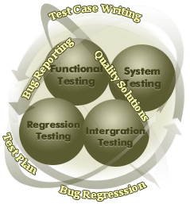
Spring features (6)
Support for application testing
Notes:
Allows to decouple software layers by injecting a component’s dependencies at runtime rather than having them declared at compile time via importing and instantiating classes.
Spring provides integration for J2EE services such as EJB, JDBC, JNDI, JMS, JTA. It also integrates several popular ORM toolkits such as Hibernate and JDO and assorted other services as well.
One of the highly touted features is declarative transactions, which allows the developer to write transaction-unaware code and configure transactions in Spring config files.
Spring is built on the principle of unchecked exception handling. This also reduces code dependencies between layers. Spring provides a granular exception hierarchy for data access operations and maps JDBC, EJB, and ORM exceptions to Spring exceptions so that applications can get better information about the error condition.
With highly decoupled software layers and programming to interfaces, each layer is easier to test. Mock objects is a testing pattern that is very useful in this regard.

Slide 17
Advantages of Spring Architecture
POJOs
Lifecycle management
Dependencies
Configuration information
Eliminate JEE dependencies
Portable

Slide 18
Spring Solutions (1)
Address major JEE problem areas:
  Web application development (MVC)
  Enterprise Java Beans (EJB, JNDI)
  Database access (JDBC, iBatis, ORM)
  Transaction management (JTA, Hibernate, JDBC)
  Remote access (Web Services, EJB, RMI)

Slide 19
Spring Solutions (2)
Each solution builds on the core architecture
Solutions foster integration, they do not re-invent the wheel

Slide 20
How to Start Using Spring
Download Spring from www.springframework.org, e.g.
spring-framework-3.0.5.zip
Unzip to some location, e.g.
C:\tools\spring-framework-3.0.5
Folder C:\tools\spring-framework-3.0.5\dist
contains Spring distribution jar files
Add libraries to your application classpath
and start programming with Spring

Slide 21
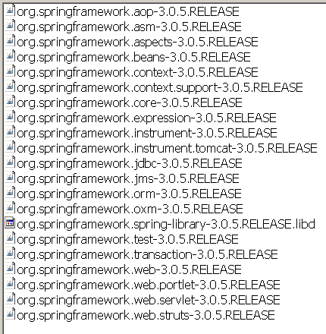
Spring jars hell ☺

Slide 22

Any Questions?

Slide 23

References
Spring in Action 2 edition
Spring documentation: http://www.springsource.org/documentation

